Slide 1
Regional Webinar Series
October 1, 2018 Flood Insurance Manual
And
Something Extra
Diana Herrera, CFM
FEMA Region 8 Sr. Insurance Specialist

Slide 2

Agenda
Policy Refresher
Cancellation Changes
Notification of PRP Eligibility on Cancellation
Newly Mapped Extension
Private Flood Options
HQ Updates
US leads the world for the most uninsurance & under-insurance
Shhh…It’s a Surprise

Slide 3

Quick Policy Refresher
-30 day waiting period – limited exceptions
-$250,000/$100,000 residential
-$500,000/$500,000 non-residential
-Foundation is covered
-Basement contents and finish work isn’t covered
-Replacement Cost Value on primary residences only
-NFIP rates don’t vary from company to company
-Anyone can buy an NFIP policy

Slide 4
Rating Factors:
-Building type (basement, elevated/non-elevated etc)
-Date of Construction
-Flood zone
-Elevation of lowest floor including basement or attached garage
Preferred Risk Policies available for any B, C or X zone
-Claims may affect qualification
-Policy bundled with building/contents coverage together

Slide 5
Definition of a Flood:
A general and temporary condition of partial or complete inundation of two or more acres of normally dry land area or two or more properties(at least one of which is the policyholder’s property) from:
  -the overflow of inland or tidal waters;
  -unusual and rapid accumulation or runoff of surface water from any source; or
  -mudflow; or
  -collapse or subsidence of land along the shore of a lake or similar body of water exceeding anticipated cyclical levels that result in a flood as defined above

Slide 6
Definition of a Building
A structure with 2 or more outside rigid walls and a fully secured roof, that is affixed to a permanent site; or
A manufactured home
A travel trailer without wheels, built on a chassis and affixed to a permanent foundation
Buildings under construction can be covered
Notes:
So, can a pole barn be covered? What about a gazebo, a lean-to with 2 walls? A mobile home?

Slide 7
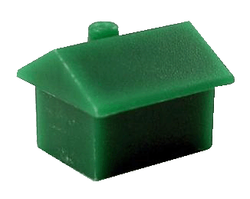

Grandfather Rules
Continuous Coverage vs. Built-in Compliance
Lock into the previous flood zone or base flood elevation
X
AE
Notes:
Other Rating Considerations – Grandfathering
Now, let’s talk about a rating tool that can be used in conjunction with FEMA map changes – Grandfathering.
It allows buildings to be rated using the flood zone or Base Flood Elevation from a prior map. It allows property owners to lock into the previous flood zone or base flood elevation for rating purposes.
Now, when the map revision involves a flood zone change, you should first look to see if the Newly Mapped procedure can be used. If Grandfathering is the only option, it can be used to lock in the flood zone and BFE information from a prior map in two different ways - Continuous Coverage and Built-in Compliance.

Slide 8

Grandfather Rules
Continuous Coverage
If policy was obtained prior to the effective date of the map change:
Rates can be based on prior zone/BFE
Continuous coverage must be maintained
Important for Pre-FIRM structure
Notes:
Other Rating Considerations – Grandfathering
Lets talk about the Continuous Coverage Rule.
If a policy is purchased prior to the effective date of a new map, then it can be rated based on the prior map’s flood zone or Base Flood Elevation.
Obviously, continuous coverage has to be maintained and, this rule has always applied to both Pre-FIRM and Post-FIRM buildings.

Slide 9
Grandfather Rules
Built-in Compliance
If building was built in compliance with FIRM in effect at time of construction:
Use old map’s zone or BFE
Submit proof to carrier
Continuous coverage not required. Mostly on Post-FIRM structures.
Notes:
Other Rating Considerations – Grandfathering
The second grandfathering option involves what is called the Built In Compliance Rule.
If a building was built in compliance with the map that was in effect at the time that it was built, then the building can be rated using that map’s flood zone or Base Flood Elevation.
Proof must be submitted to the carrier and continuous coverage is not required for this option. Typically, this part of the rule applies to Post-FIRM buildings.

Slide 10
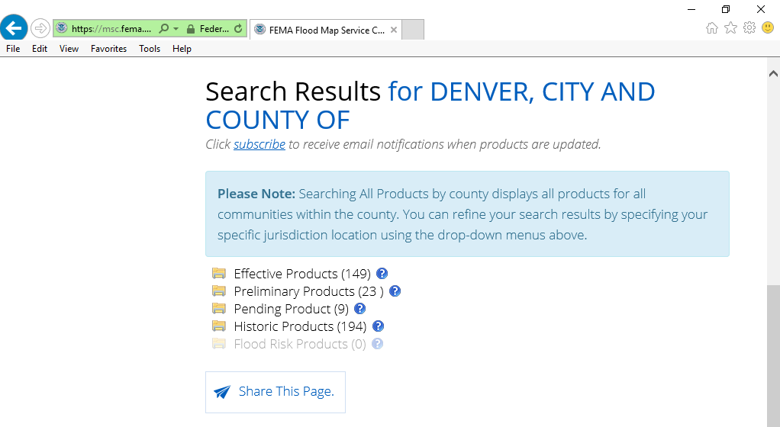
Grandfather Rules
Locate Historic Flood Maps
Built-in Compliance
https://msc.fema.gov/portal/
Notes:
Other Rating Considerations – Grandfathering
Since proof of the "built in compliance rule" is required, it is possible to view and print out a copy of prior or historic flood maps. Go back to the Map Service Center.
Just click on the “Search All Products” link and search for the community or jurisdiction by name or drop down menu. It will give you a list of the historic mapping products for that community. You can make a FIRMette from an old - historic map.

Slide 11
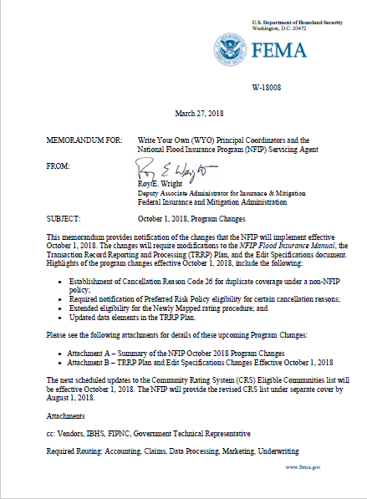
WYO Bulletin
W-18008
Issued: March 27, 2018
https://nfipservices.floodsmart.gov/sites/default/files/w-18008.pdf
Notes:
The changes outlined in this bulletin apply to new business, renewals, endorsements, and cancellations that will become effective on or after October 1, 2018.

Slide 12
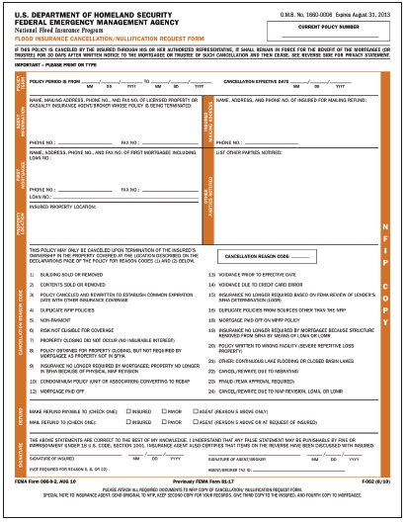

New Cancellation Code 26
Duplicate Coverage under Non-NFIP Policy
Same Building as on NFIP Policy
Cancellation Date-receipt by company
Cancellation Request-same year
Pro-Rata – Current Year ONLY
Required Documentation
Notes:
Beginning October 1, 2018, FEMA will establish Cancellation Reason Code 26 to allow cancellation of an NFIP policy when a policyholder has obtained a duplicate policy from sources other than the NFIP. The non-NFIP insurance coverage must be for building coverage on the same building that is insured by the flood policy being canceled.
Cancellation Effective Date: The date the cancellation request is received by the insurer.
Type of Refund: Pro-rata refund including ICC premium, Reserve Fund Assessment, and HFIAA Surcharge. The refund does not include the Federal Policy Fee and Probation Surcharge (if applicable).
Cancellation Request: Must be received within the current NFIP policy year.
Required Documentation: A copy of the non-NFIP policy’s declaration page and a statement from the mortgagee, if any, accepting the non-NFIP policy as the replacement.
Years Eligible for Refund: Current year.

Slide 13
Required Notification of PRP Eligibility for Certain Cancellation Reasons
On Standard-rated X zone policies
Must inform of option to convert to PRP
Inform prior to Cancellation Reasons
  Code 8-Not required by mtge.
  Code 9-Not required by mtge from PMR or LOMR
  Code 15-Not required based on LODR
  Code 19-Not required based on LOMA
  Documentation
  Canc/Rewrite to PRP using 22or 24
Notes:
Effective October 1, 2018, NFIP insurers must inform eligible policyholders with standard-rated policies for property in a non-Special Flood Hazard Area (SFHA) of their option to convert to the Preferred Risk Policy (PRP). They must inform policyholders prior to processing cancellations for the following Cancellation Reason Codes:
Reason Code 8 – Policy Not Required by Mortgagee
Reason Code 9 – Insurance No Longer Required by Mortgagee Because Property Is No Longer Located in a Special Flood Hazard Area Because of a Physical Map Revision (PMR) or Letter of Map Revision (LOMR).
Reason Code 15 – Insurance No Longer Required Based on FEMA Review of Lender’s Special Flood Hazard Area Determination called a Letter of Determination Review (LODR).
Reason Code 19 – Insurance No Longer Required by the Mortgagee Because the Building Has Been Removed from the SFHA by Means of a Letter Of Map Amendment (LOMA0
To implement this requirement, NFIP insurers may develop notice requirements that align with their normal business practices. NFIP insurers must be able to demonstrate that they informed eligible policyholders of the availability of the PRP. Insurers may cancel/rewrite the policy to a PRP using the current cancel/rewrite procedures outlined in Cancellation Reason Code 22 or 24, as appropriate.

Slide 14
Extended Eligibility for Newly Mapped Raging Procedure
Current process-12 months to write policy from effective date of the map
Expanding to be either:
  Within 12 months of map revision date, or,
  Within 45 days of initial lender notification if the notification occurs within 24 months of the map revision date.
  Newly Mapped multiplier based on map date and policy effective date
Notes:
FEMA is extending the time period for properties newly mapped into an SFHA to be rated using the Newly Mapped rating procedure instead of going immediately to full-risk (actuarial) rating.
Currently, properties newly mapped into an SFHA are eligible for the Newly Mapped rating procedure if the applicant obtains coverage that is effective within 12 months of the map revision date. Effective October 1, 2018, FEMA is expanding eligibility to be either within 12 months of the map revision date or within 45 days of initial lender notification if the notification occurred within 24 months of the map revision date. In these cases, the Newly Mapped multiplier to be used for premium calculation should be based on the map effective date and the policy effective date for that new business transaction.

Slide 15
So What is All the Buzz About Private Flood Insurance?!

Slide 16
Emerging Private Flood Insurance vs. NFIP
4.8 million NFIP policies nationally
Private market accounts for only 3.5-4.5% of all primary flood policies
Funded by global reinsurers – 90% of total risk
No data to show how many prior underinsured/uninsured are buying directly from private carriers
  Taken from recent Wharton Article: The Emerging Private Residential Flood Insurance Market in the United States

Slide 17
Interesting Stats from the Wharton Report
AIR Inland Flood Model estimates:
  -60% of annual average loss from riverine flooding
  -40% from storm water flooding
  -Properties outside SFHA account for 30% of annual claim rate
  -30% claim rate not statistically different than inside SFHA’s

Slide 18
Various Types of Private Flood Insurance
NFIP+
Homeowner’s Endorsement Policy
-Lower limits of up to $50,000-lower risk areas
-May offer an ICC endorsement with higher limits
NFIP policy mimic
Some copy homeowner’s language rather than NFIP

Slide 19
Private Market is Limiting Risk
No –BFE properties allowed generally
Rep loss or high tide properties or prior claims=NO GO!
Limits how many policies it has in a certain zip code
Limits policies to outside A or V or within 25 meters of those zones
Shorter waiting periods generally than the NFIP
Private insurers support substantial public investment in risk reduction

Slide 20
Surprising Comments by Private Insurer’s and Reinsurer’s
X zone rating was too low for them to compete
Companies felt their mapping data was more accurate
Other underwriters said one risk mapping tool wasn’t enough
Pre-FIRM homes were overpriced and targeted those with better rates than the NFIP
Coastal properties were overpriced by the NFIP
X zones were underpriced for rainfall flooding

Slide 21
Surprising Comments by Private Insurer’s and Reinsurer’s
Another firm believed coastal was underpriced
Some companies are targeting high end homes with higher policy limits
Or others target homes a few blocks back from the beach, well built, lower value
Some target only 2nd homeowners since the NFIP pricing is now higher
What the heck???

Slide 22
The Key to All Private Policy Underwriting?
Choosier so it allows for better loss ratios
Can adjust to market changes more quickly
Find niches to be more competitive
If market demanded it-flood would be on homeowner’s policy
WYO’s will be able to have private policies 10-1-2018
National Association of Insurance Commissioners requesting private companies report flood policy data

Slide 23

FEMA HQ Updates
Moonshots: 50% policy increase goal either thru the NFIP or private policies
Change of messaging: “Protect the Life You’ve Built”
-less doom and gloom images
Check Floodsmart regularly for new materials
If your print materials are older than 2016-toss ‘em!
Renewal – 5 touches before policy expires so be prepared for questions on the mailings

Slide 24

Resources
Diana Herrera
303-235-4988
Diana.Herrera@fema.dhs.gov
Erin May
303-674-1449
Erin.may@associates.fema.dhs.gov
https://nfipservices.floodsmart.gov/
https://nfipservices.floodsmart.gov/wyobull2018.html

Slide 25
Q & A

