Slide 1
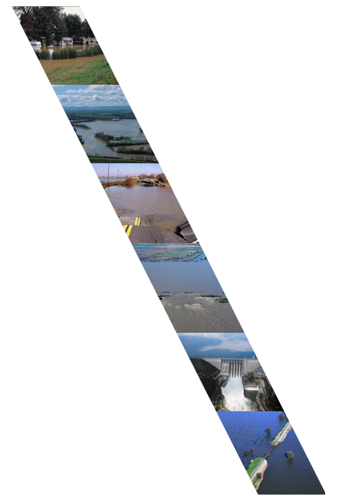
Working Together to Reduce Flood Risk: Silver Jackets Interagency Partnerships
Melissa Weymiller, USACE
Project Manager
Flood Risk Management Program

Slide 2
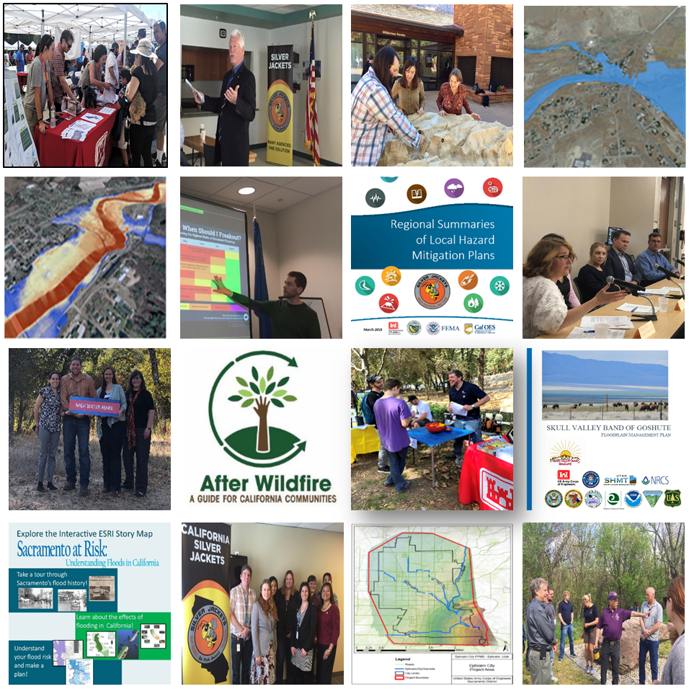
Silver Jackets
Interagency Program to Reduce Flood Risk
State Led Teams
Competitive Project Proposals
12-18 month Projects
Notes:
Building off what Jennifer has said, no single agency has the complete solution — each has one or more pieces, and Silver Jackets is the forum where all agencies come together to put their programs together and implement a solution. To achieve communities that are sustainable and resilient to natural disasters, especially flooding, partnerships are an important part of success. We want to have these partnerships in place so that we can better respond and prepare for disasters as a team.
Silver Jackets projects are done with in-kind services from each agencies, and each team is state led. I’ll talk a little bit about the type of projects we have worked on and the importance of our partnerships.

Slide 3
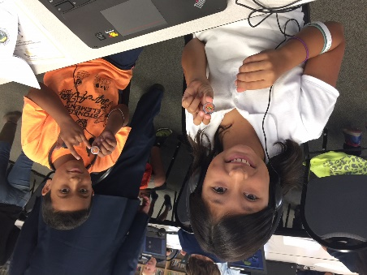
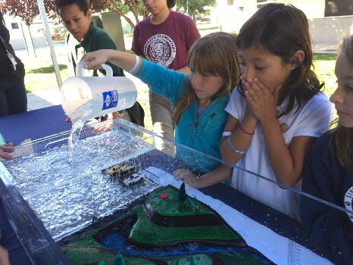
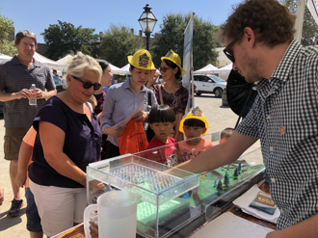
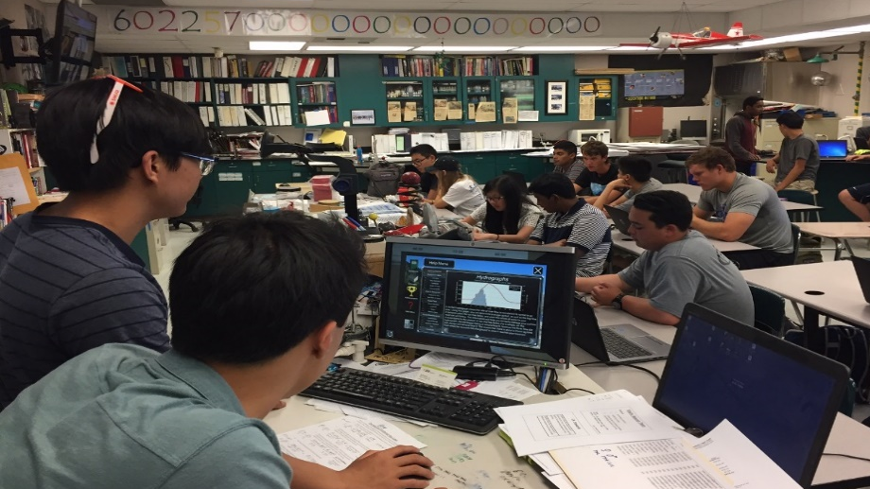
Education and Outreach Events
Provide booths and watershed or flood models for existing events
Attend or facilitate school programs
Host flood outreach events, e.g. a Disaster Movie Marathon, Flood Preparedness Day
Hold training events for floodplain managers
Notes:
The Minnesota Silver Jackets team has developed an Emergency Action Plan Guidebook that provide step-by-step instructions for developing a plan. It is focused on smaller communities and Tribes, but is a great start for communities developing an EAP. Silver Jackets can also provide support to communities interested in developing it. We have done many one day workshops focusing on developing the plan and free tools that exist to increase your floodplain. The guidebook includes 21 forms or samples to help you create your plan and 62 links to other examples, guidebooks, and related articles. To find it, you can google Emergency Action Plan Silver Jackets, the link is currently down, but we are working on getting it back online.

Slide 4
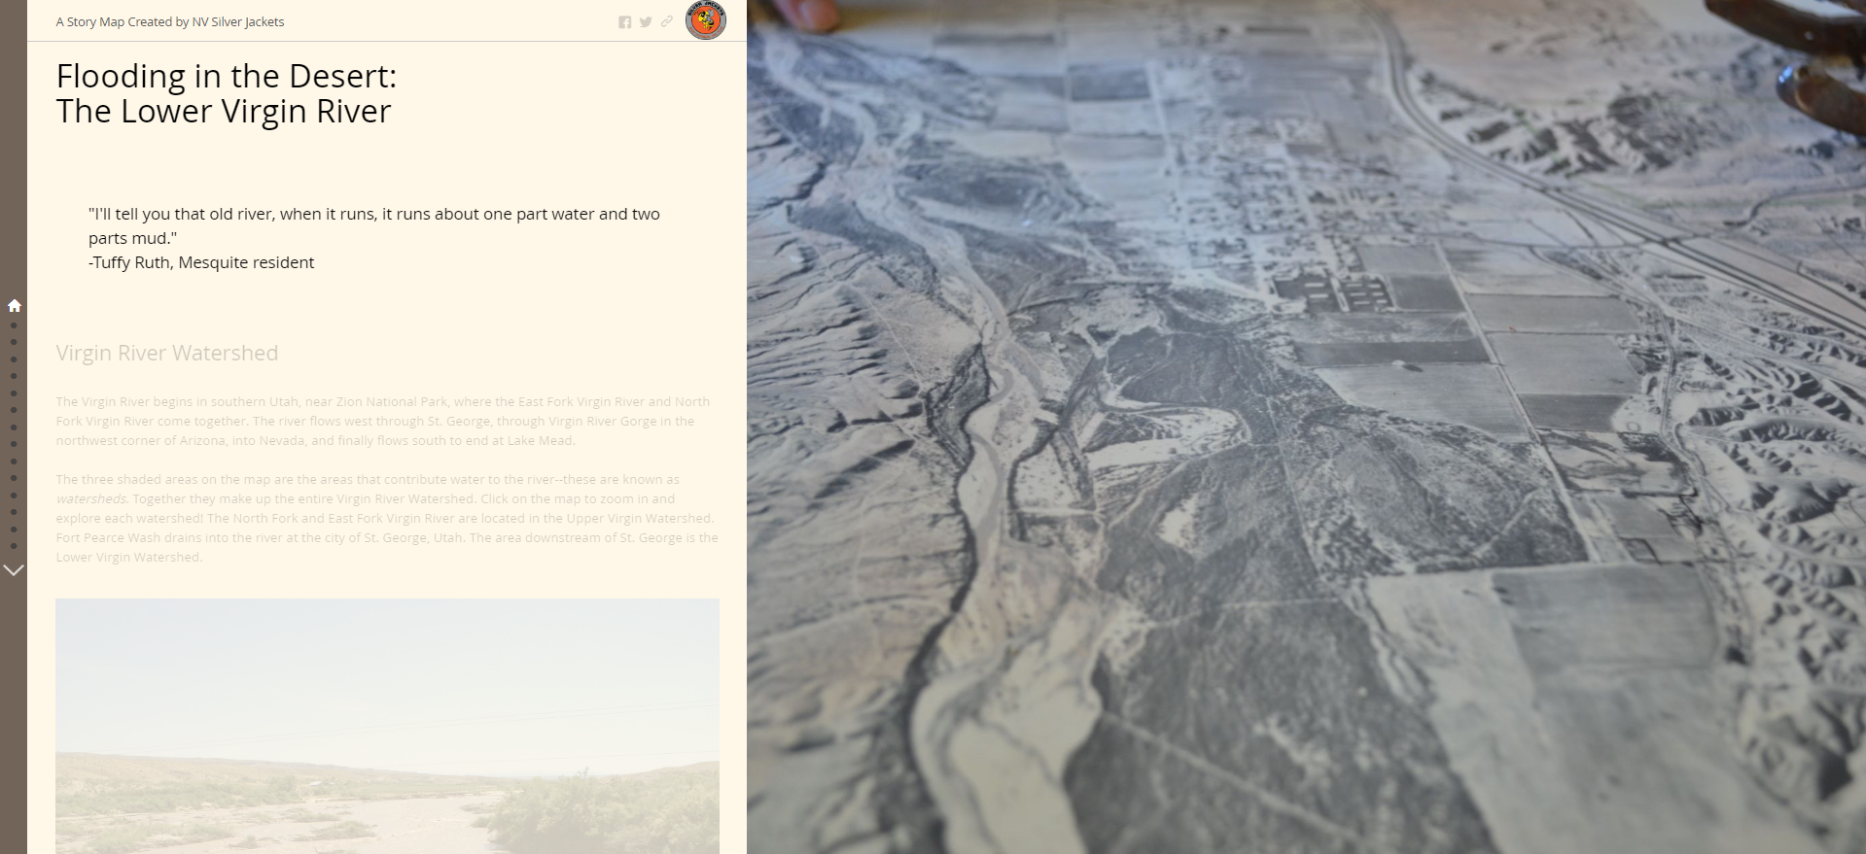
Flood History Outreach
Produce ESRI Storymaps
Virgin River Flood History
https://arcg.is/1TiCaH
Create brochures
Develop Walking Tours
Notes:
The Minnesota Silver Jackets team has developed an Emergency Action Plan Guidebook that provide step-by-step instructions for developing a plan. It is focused on smaller communities and Tribes, but is a great start for communities developing an EAP. Silver Jackets can also provide support to communities interested in developing it. We have done many one day workshops focusing on developing the plan and free tools that exist to increase your floodplain. The guidebook includes 21 forms or samples to help you create your plan and 62 links to other examples, guidebooks, and related articles. To find it, you can google Emergency Action Plan Silver Jackets, the link is currently down, but we are working on getting it back online.

Slide 5
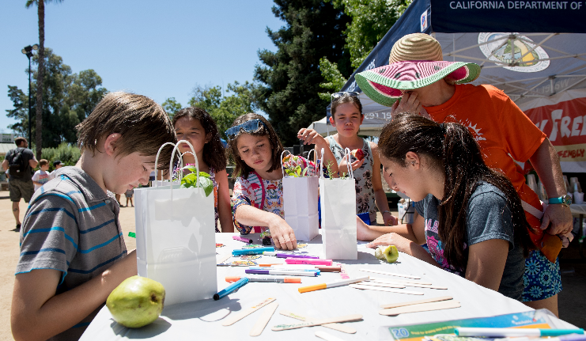
Emergency Action Planning Guidebook
Step-by-step instructions for developing an EAP
Focused on small and medium sized communities
Silver Jackets can provide support for communities developing EAPs
Notes:
The Minnesota Silver Jackets team has developed an Emergency Action Plan Guidebook that provide step-by-step instructions for developing a plan. It is focused on smaller communities and Tribes, but is a great start for communities developing an EAP. Silver Jackets can also provide support to communities interested in developing it. We have done many one day workshops focusing on developing the plan and free tools that exist to increase your floodplain. The guidebook includes 21 forms or samples to help you create your plan and 62 links to other examples, guidebooks, and related articles. To find it, you can google Emergency Action Plan Silver Jackets, the link is currently down, but we are working on getting it back online.

Slide 6
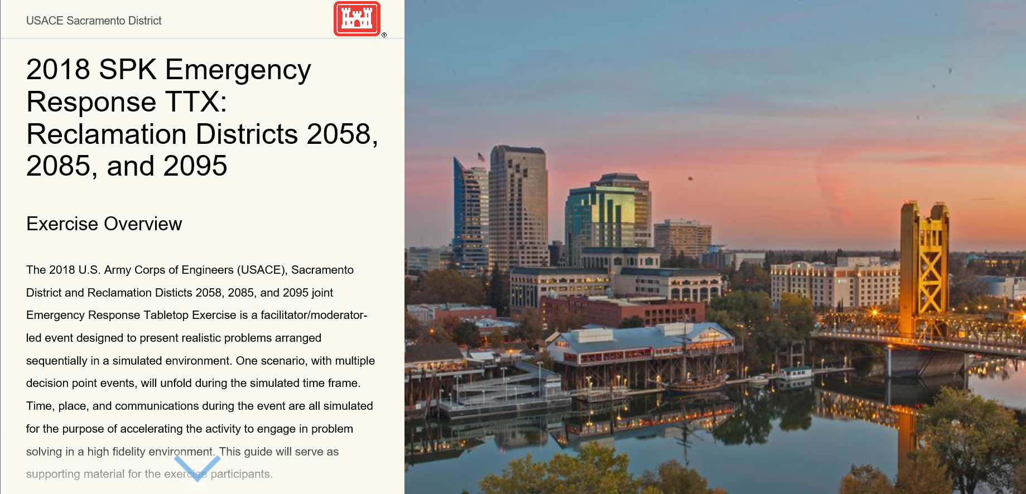
Tabletop Exercises
Exercise a community’s Emergency Response Plan
Incorporate real life challenges
Facilitate coordination between stakeholders
Notes:
Once you have your EAP, Silver Jackets can also help you practice your plan. Army Corps has a center of expertise that works with Silver Jackets to develop interactive tabletop exercises. We create story maps with interactive videos that help set the stage for the event you are preparing for. It can also incorporate local challenges, not outlined in the EAP. For the one highlighted here, we incorporated changes the community was experiencing in false information being spread over social media and how the reclamanation districts could overcome that challenge. These exercises facilitate communication and coordination between the stakeholders and help you identify improvements you can make in your EAP.

Slide 7
Questions
Melissa Weymiller, USACE Melissa.M.Weymiller@usace.army.mil (916)557-5281

